Slide 1



Noida Institute of Engineering and Technology, Greater Noida
Introduction to Digital Marketing
Unit: 1
DIGITAL MARKETING
Dr. Priyanka Malhotra
MBA Department
B.Tech CSE Semester VI

Slide 2

Index/Content
S. No. | Index
1. | Name of Subject with code, Course and Subject Teacher
2. | Brief Introduction of Faculty member with Photograph
3. | Evaluation Scheme
4. | Syllabus
5. | Branch wise Application
6. | Course Objective(s)
7. | Course Outcome(s)
8. | Program Outcomes (POs)
9. | COs and POs Mapping

Slide 3
Index/Content
S. No. | Index
10. | Program Specific Outcomes (PSOs)
11. | Cos and PSOs Mapping
12. | Program Educational Objectives (PEOs)
13. | Result Analysis
14. | End Semester Question paper Templates
15. | Prequisite/Recap
16. | Brief Indtroduction about the Subject with Videos
17. | Unit Contents
18. | Unit Objectives
19. | Topic Objectives/Topic Outcome

Slide 4
Index/Content
S. No. | Index
20. | Lecture related to topic
21. | Daily Quiz
22. | Weekly Assignment
23. | Topic Links
24. | MCQs
25. | Glossary Questions
26. | Old question papers
27. | Expected Questions
28. | Recap of unit

Slide 5
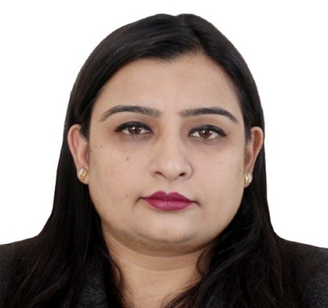
Noida Institute of Engineering and Technology, Greater Noida
Dr. Priyanka Malhotra
Assistant Professor
Department: Management Studies
Email ID: priyankamalhotra@niet.co.in
Qualification: BBA, MBA, UGC NET, Ph.D
Specialisation: HRM & OB
Total Teaching Experience: 14 years
Teaching Area: HR and Marketing

Slide 6
Evaluation scheme

Slide 7

Syllabus
UNIT-I | Introduction to Digital Marketing | Hours- 8
Introduction to Digital Marketing: Concept of Marketing, the new digital world - trends that are driving shifts from traditional marketing practices to digital marketing practices, the modern digital consumer and new consumer’s digital journey. Marketing strategies for the digital world-latest practices.
UNIT-II | Social Media Marketing | Hours-8
Introduction to Blogging, Create a blog post for your project. Include headline, imagery, links and post, Content Planning and writing. Introduction to Face book, Twitter, Google +, LinkedIn, YouTube, Instagram and Pinterest; their channel advertising and campaigns
UNIT-III | Acquiring & Engaging Users through Digital Channels | Hours-8
Understanding the relationship between content and branding and its impact on sales, search engine marketing, overview of search engine optimization (SEO), mobile marketing, video marketing, and social-media marketing. Marketing gamification, marketing analytic tools to segment, target and position.

Slide 8
Syllabus
UNIT-IV | Designing Organization for Digital Success | Hours-8
Digital transformation, digital leadership principles, online P.R. and reputation management. ROI of digital strategies, how digital marketing is adding value to business, and evaluating cost effectiveness of digital strategies
UNIT-V | Digital Innovation and Trends |  | Hours-8
The contemporary digital revolution, digital transformation framework; security and privatization issues with digital marketing Understanding trends in digital marketing – Indian and global context, online communities and co-creation.

Slide 9
Applications
With the advent of new technologies, the field of Marketing has seen a paradigm shift over the years.
Though it is still in use, businesses across the world have switched from traditional modes of marketing to digital marketing.
This, in turn, has created many new opportunities for companies to expand their business and has created tremendous employment opportunities across sectors.
From Content curation and management to Social Media Marketing and Brand Management, a career in Digital Marketing can take you in several directions.
Top Job Profiles: Digital Marketing Manager, Social Media Manager, Content Writer, Data and Market Analytics Manager

Slide 10
Course Objectives
1 | Provide understanding of digital and social media marketing practices.
2 | Provide understanding of different social media platforms
3 | Impart learning on various digital channels and how to acquire and engage consumers online.
4 | Provide insights on building organizational competency by way of digital marketing practices and cost considerations.
5 | Develop understanding of the latest digital practices for marketing and promotion.

Slide 11
Course Outcomes
CO 1 | Develop an understanding of digital and social media marketing practices. | Knowledge (K2), Remembering (K1)
CO 2 | Develop understanding of the social media platforms | Comprehending (K 3)
CO 3 | Acquire the skill to acquire and engage consumers online | Knowledge (K2), Applying (K4)
CO 4 | Develop understanding of building organizational competency by way of digital marketing practices and cost considerations | Knowledge (K2), Analyzing (K5)
CO 5 | Develop understanding of the latest digital practices for marketing and promotion. | Knowledge (K2), Applying (K4)

Slide 12
Program Outcomes
PO1: Knowledge of Management theories and practices
PO2: Analytical & Critical thinking abilities
PO3: Value based leadership
PO4: Understand, analyze and communicate all aspects of business
PO5: Achievement of Organizational goals

Slide 13
CO-PO Mapping
High=3,Medium =2 ,Low=1

Slide 14
Program Educational Objectives
PEO 1: To have an excellent scientific and engineering breadth so as to comprehend, analyze, design and provide sustainable solutions for real-life problems using state-of-the-art technologies.
PEO 2: To have a successful career in industries, to pursue higher studies or to support entrepreneurial endeavors and to face the global challenges.
PEO 3: To have effective communication skills, professional attitude, ethical values and a desire to learn specific knowledge in emerging trends, technologies for research, innovation and product development and contribution to society.
PEO 4: To have life-long learning for up-skilling and re-skilling for a successful professional career as an engineer, scientist, entrepreneur or bureaucrat for the betterment of the society.

Slide 15
Program Specific Objectives
The ability to identify, analyze real world problems and design their ethical solutions using artificial intelligence, robotics, virtual/augmented reality, data analytics, block chain technology, and cloud computing.
The ability to design and develop the hardware sensor devices and related interfacing software systems for solving complex engineering problems.
The ability to understand inter-disciplinary computing techniques and to apply them in the design of advanced computing.
The ability to conduct investigation of complex problems with the help of technical, managerial, leadership qualities, and modern engineering tools provided by industry-sponsored laboratories.

Slide 16
Result Analysis
Subject Name & Code | Total No. Of Students | Pass % | 40>65 (%) | 65>75 (%) | 75>90 (%) | 90 & Above (%) | Backlog | Average Marks

Slide 17
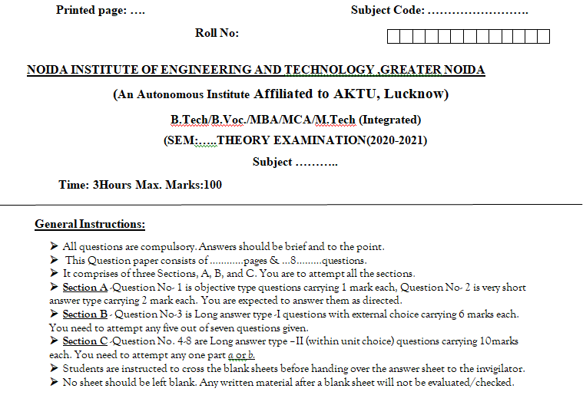
End Semester Question Paper Template

Slide 18
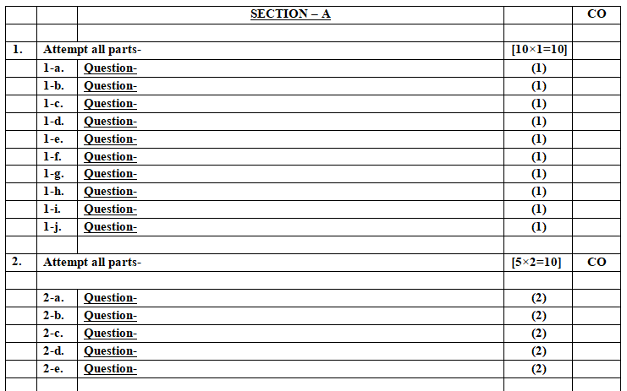
End Semester Question Paper Template

Slide 19
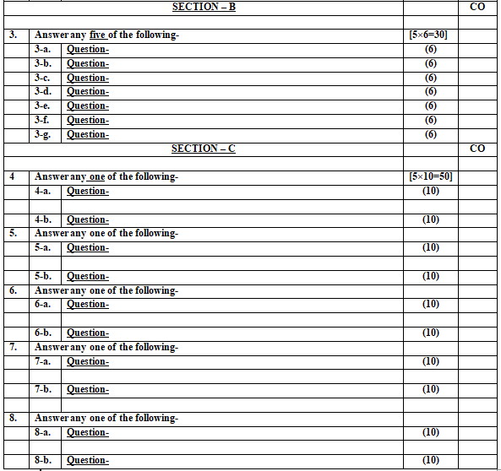
End Semester Question Paper Template

Slide 20
Prerequisite and Recap
Pre-requisites: Understanding of Basics of marketing concepts and social media platforms

Slide 21
Introduction of the subject
The course is designed to make learner conversant with Digital Marketing and proficient in Social Media tools and techniques starting from the fundamentals of digital marketing.
Social media websites and applications allow users to create and exchange user-generated content where people talk, share information, participate and network through technologies such as blogs and social networking sites.
Within the last decade, social media has become one of the most powerful sources for news updates, online collaboration, networking, viral marketing and entertainment.
https://www.youtube.com/watch?v=Xuq6_udbeH0&list=PLi3oNa09iwJRByiNwEJNaZ3XVKcveovzk
https://www.youtube.com/watch?v=X-pCbWwu50k

Slide 22
Unit Contents
Introduction to Digital Marketing (CO1)
The new digital world - digital marketing practices(CO1)
The modern digital consumer (CO1)
New consumer’s digital journey (CO1)
Marketing strategies for the digital world-latest practices. (CO1)

Slide 23
Objectives of the Unit
To make the students understand the Digital marketing trends.
To understand the new digital world.
To make the students aware of different types of digital customers.

Slide 24

Noida Institute of Engineering and Technology, Greater Noida
(Unit –I) Topic 1
Introduction to Digital Marketing

Slide 25
Session Objectives
1. To develop a general understanding on Digital Marketing among the students.
2. To help students gain insights as to why digital marketing is gaining so much importance .
3. To enable students understand the shift from traditional to digital marketing.

Slide 26
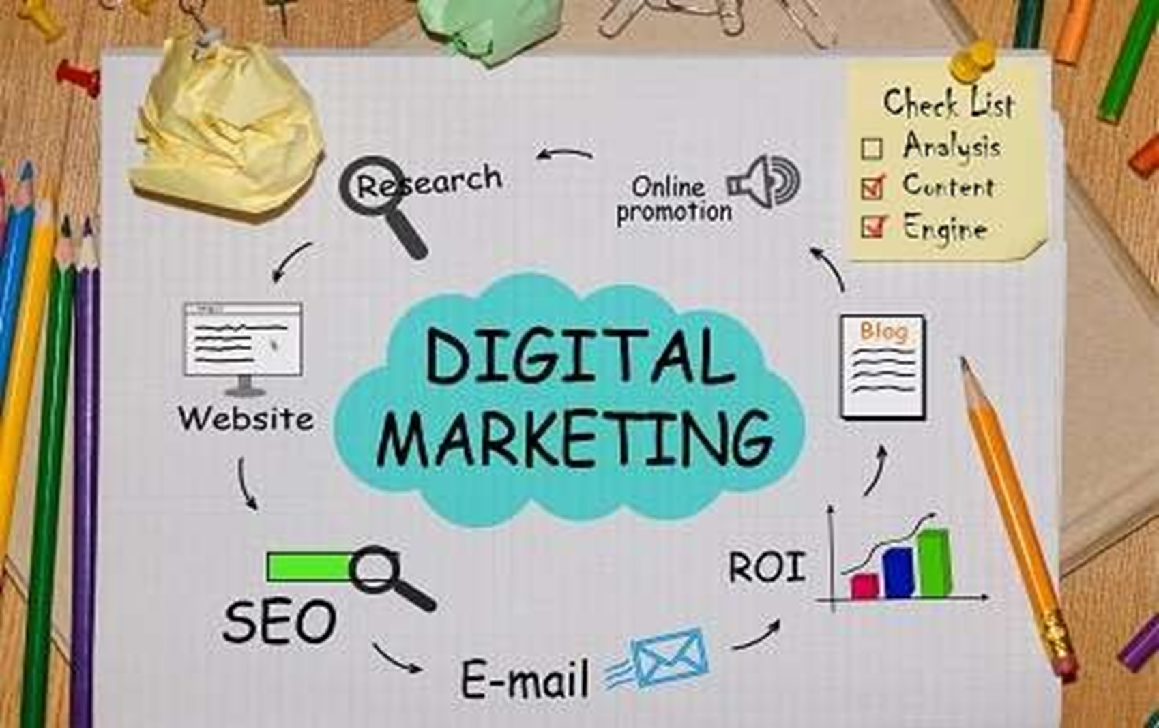
Digital Marketing(CO1)

Slide 27
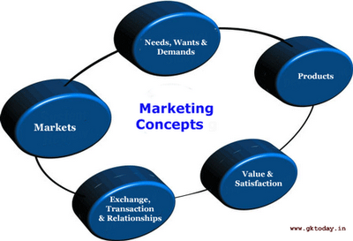
Marketing and Digital Marketing(CO1)
According to Kotler (2000) – Marketing is “A societal process by which individuals and groups obtain what they need and want through creating, offering, and freely exchanging products and services of value with others.”
Notes:
In essence, this extension to non-Internet channels helps to differentiate digital marketing from online marketing, another catch-all term for the marketing methods mentioned above, which strictly occur online.

Slide 28
Marketing and Digital Marketing(CO1)
Digital marketing is the marketing of products or services using digital technologies, mainly on the Internet, but also including mobile phones, display advertising, and any other digital medium.
It now extends to non-Internet channels that provide digital media, such as mobile phones (SMS and MMS), callback, and on-hold mobile ring tones.
Notes:
In essence, this extension to non-Internet channels helps to differentiate digital marketing from online marketing, another catch-all term for the marketing methods mentioned above, which strictly occur online.

Slide 29
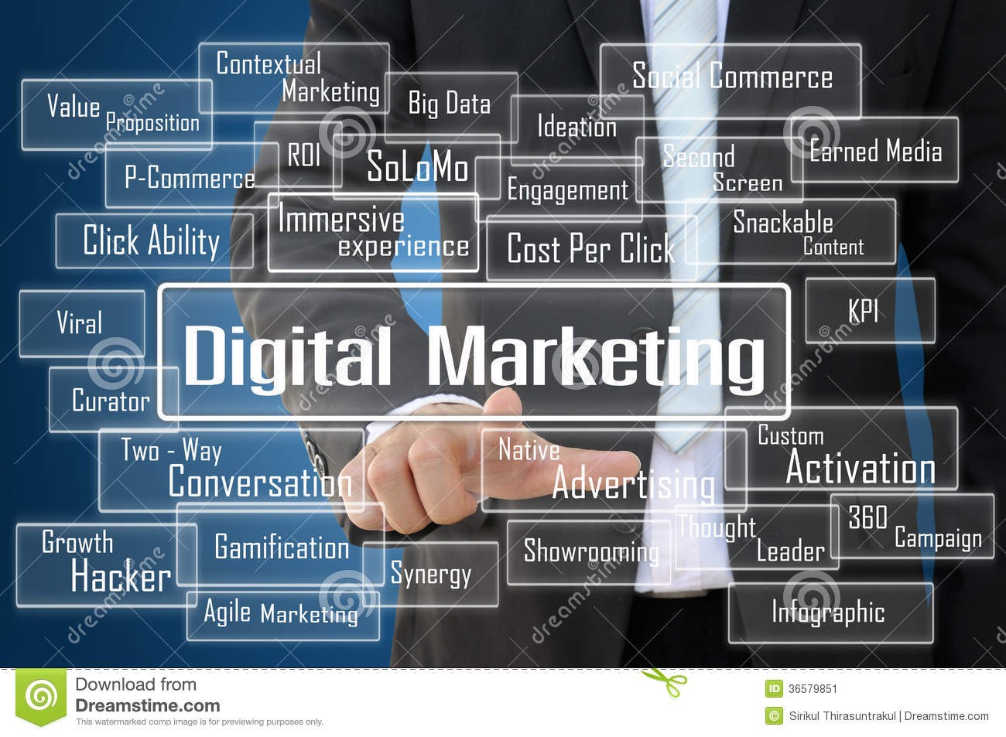
Digital Marketing(CO1)
Notes:
In essence, this extension to non-Internet channels helps to differentiate digital marketing from online marketing, another catch-all term for the marketing methods mentioned above, which strictly occur online.

Slide 30
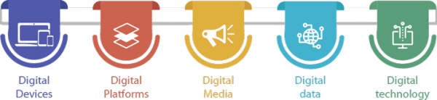
The 5Ds of digital marketing(CO1)
Notes:
1. Digital devices
This device helps the audiences to interact with the brands through various digital methods.
The various digital devices include:
Mobile phones
Laptops,
Gaming devices
Television.
These devices help customers to stay connected with brands constantly.
2. Digital platform
A browser works as a medium that helps to create interactions between brands and customers.
Among digital platforms, social media is the largest and it has users more than half of the world population. Reports say that social media receive 950,000 new users each day.
Applications and browsers digital platforms include:
Google
YouTube
Twitter
LinkedIn
Facebook
3. Digital media
This refers to paid, and owned communications channels which helps to build engagement with the target market using several ways includes,
Advertising emails
Messaging
Search engines
Social networks.
4. Digital data
This consists of customers profiles and engagement patterns with businesses. Collect data about consumers, which gives u the insight on their interest, and curate their buying decisions for promoting. This data is used for cross-selling, Improving user experience, and increasing customers buying rate. This analysis also helps to promote new products and its use cases.
Here are some of the ways to collect this data digitally such as:
Website contacts form
POS
Contests
Surveys,
Event sign-ups
App installation
5. Digital technology
These are electronic tools, systems, devices and resources that help to generate, store or process data. For example, artificial intelligence, cloud computing, virtual reality, big data and Internet of Things. It focuses on building interactive experiences across various platforms.
Artificial Intelligence helps businesses to collect more data about their audience. Then, they use these data to offer:
Predictive search
Chatbots
Recommendation engines

Slide 31

Why Are Businesses shifting from Traditional marketing to Digital Marketing? (CO1)
Targeting a specific audience with specific demographics
It’s Good On The Pocket
Find The World At Your Fingertips
It Gives You The Proofs through tools which give all the data, analytics, and reports
It Makes For A Two way Interaction
Notes:
Targeting-Digital marketing allows businesses to target a specific audience with specific demographics. It also allows for very personalized targeting. Traditional Marketing in turn, are not highly specific in its targeting.
It’s Good On The Pocket: Traditional Marketing such as print ads, broadcasting, etc. takes a great chunk out of your budget. As opposed to it, Digital marketing is rather cost friendly. You can build your website free on WordPress and SEO can get you organic i.e. not paid traffic to your website, which can get you customers who buy your products/services.
Find The World At Your Fingertips: Unlike Traditional Marketing which is restricted to a region or even nation, Digital Marketing gives you a global reach. You can market and promote your business to the global audience and market. Thus, you get a larger reach.
It Gives You The Proofs: Once you put in a newspaper ad or TV ad or poster, you don’t really glean any information on how many people were inspired to buy your product/service by any specific Traditional Marketing Medium. Digital Marketing comes with tools which give all the data, analytics, and reports, on any one or more marketing campaigns you are running.
It Makes For A Two way Interaction: Traditional Marketing is a rather one way interaction. A advertisement on TV, radio, newspaper, etc. Digital Marketing however, allows for a two way interaction, so that the audience/reader can put in his/her opinions and even questions.

Slide 32
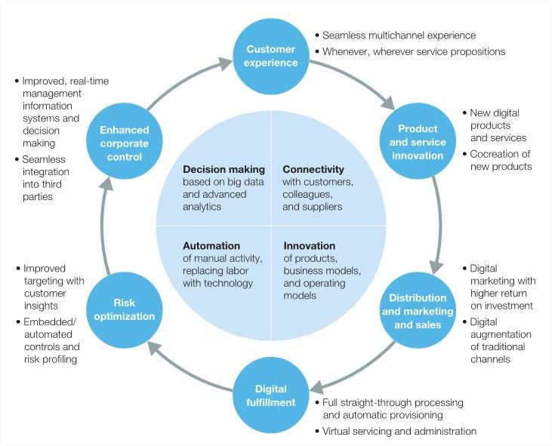
Why Are Businesses shifting from Traditional marketing to Digital Marketing? (CO1)

Slide 33
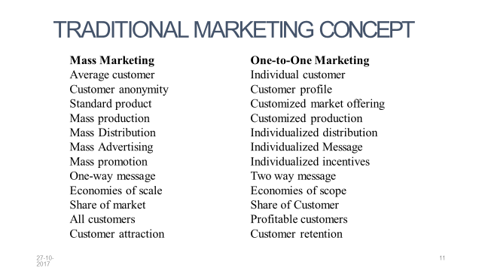
Why Are Businesses shifting from Traditional marketing to Digital Marketing? (CO1)

Slide 34
Some facts about Indian Digital Marketing Industry
(CO1)
As per a report by IAMAI (Internet and Mobile Association of India)and Boston consulting group, India has one of the largest and fastest growing populations of Internet users in the world—190 million as of June 2014 and growing rapidly.
According to a report, India will cross 500 million Internet Users Mark in 2022
According to Direct Marketing Association, Digital Marketing Industry is worth $62 billion
Reference: https://www.researchgate.net/publication/303163963_Digital_Marketing_in_Indian_Context

Slide 35
Daily Quiz
Define Digital marketing.
5 D’s of Digital Marketing are______
Which of the following is the correct depiction of Digital Marketing?
E-mail Marketing
Social Media Marketing
Web Marketing
All of the above
4. Which is a bigger concept : Selling or marketing?
5. Give 2 reasons for growing importance of Digital Marketing.

Slide 36
Noida Institute of Engineering and Technology, Greater Noida
(Unit –I) Topic 2
The new digital world - digital marketing practices

Slide 37
Recap
Digital marketing is the marketing of products or services using digital technologies, mainly on the Internet.
Digital importance is gaining impetus because of its wide & targeted reach, customer friendly and cost effective approach.

Slide 38
Session Objectives
1. To develop a general understanding on Trend change in Digital Marketing among the students.
2. To explain the Marketing Practices For The digital World

Slide 39
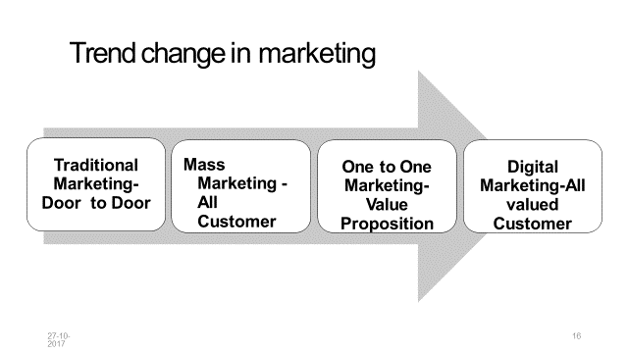
Trend Change in Marketing (CO1)

Slide 40
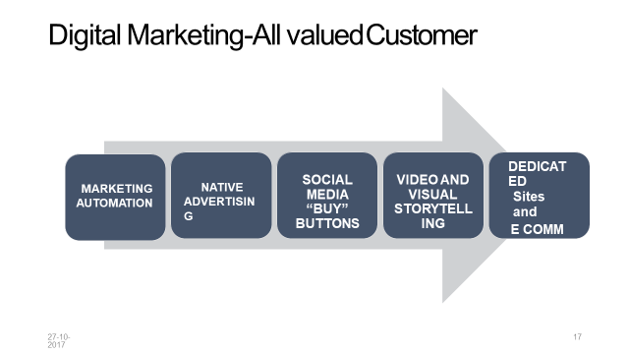
Marketing Practices For The Digital World(CO1)

Slide 41
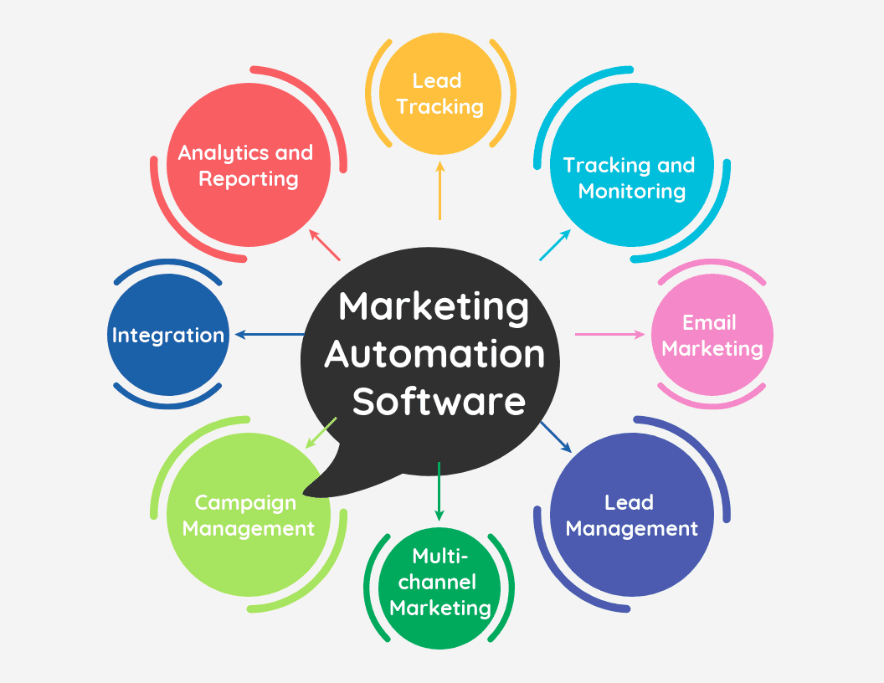
Marketing Practices For The Digital World(CO1)
1. Marketing Automation

Slide 42
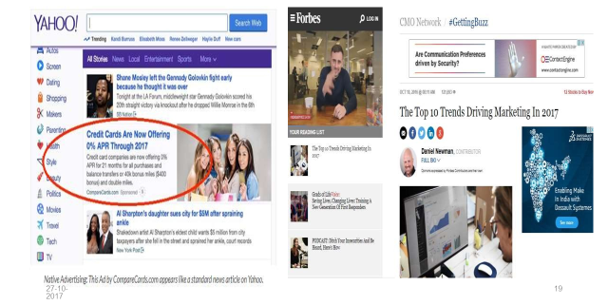
Marketing Practices For The Digital World(CO1)
2. Native ads
Often feature as recommended content on websites, appearing below or beside the article you just read. Can be “in feed”.
Search and promoted listings that appear at the top of your Google search results, or in the sidebar.

Slide 43
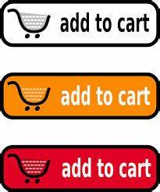
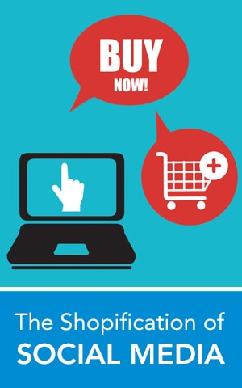
Marketing Practices For The Digital World (CO1)
3. Buy Buttons

Slide 44
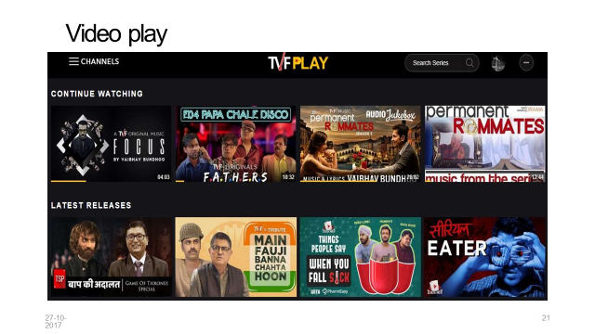
Marketing Practices For The Digital World(CO1)
4.

Slide 45
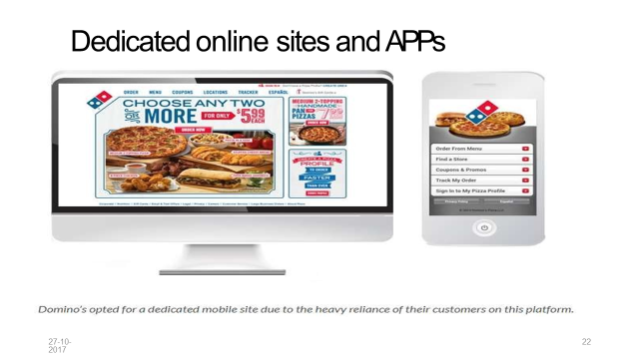
Marketing Practices For The Digital World(CO1)
5.
5.

Slide 46
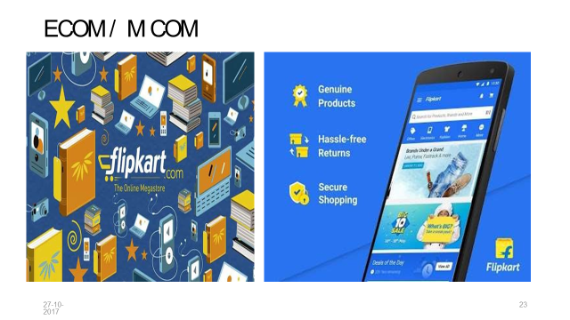
Marketing Practices For The Digital World(CO1)
6.

Slide 47
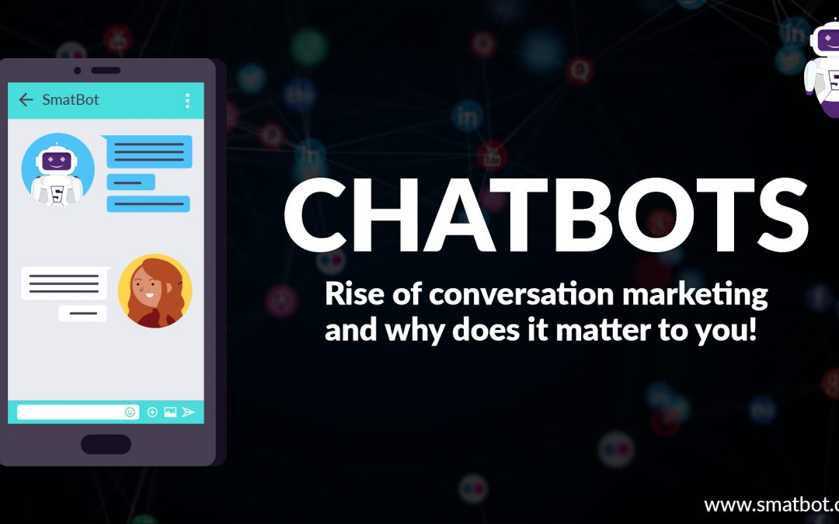
Marketing Practices For The Digital World(CO1)
7. Chatbots & Conversational Marketing

Slide 48

Marketing Practices For The Digital World(CO1)
8. Voice Search

Slide 49
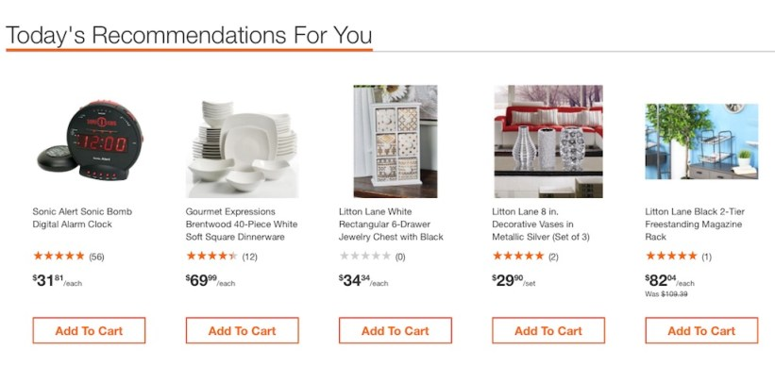
Marketing Practices For The Digital World(CO1)
9. Personalization

Slide 50
Daily Quiz
Name any 2 marketing strategies for the digital world.
Define Marketing Automation.
_______ is the use of paid ads that match the look, feel and function of the media format in which they appear.
Dedicated online sites are ______.
E-com stands for _________.

Slide 51
Noida Institute of Engineering and Technology, Greater Noida
(Unit –I) Topic 3
The modern digital consumer and its journey

Slide 52
Recap
Marketing Practices For The Digital World are:
Marketing Automation
Native marketing
Social media ‘buy buttons’
Video/ Visual story telling
Dedicated sites and apps
E-commerce

Slide 53
Session Objectives
1. To discuss the digital consumer journey
2. To make the students aware about different types of Digital customers.

Slide 54
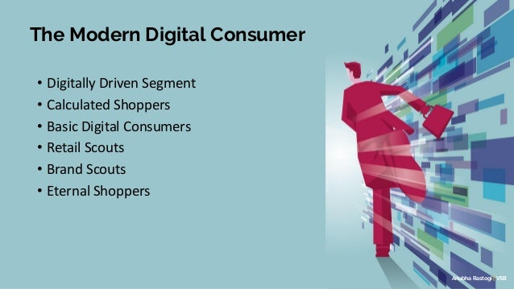
Digital consumer (CO1)
A digital consumer may be defined as e-consumer, looking for and purchasing products on the Internet, taking advantage of the content published on-line, aware of themselves and of their needs, and keen on simplifying the decisions they need to make.
Notes:
In some cases, the digital customer journey can extend beyond the act of purchase or subscription; to customer loyalty. For example, the brand may offer personalized post-sale offers or adapted content to improve the buyer’s knowledge and experience of their newly purchased product.

Slide 55
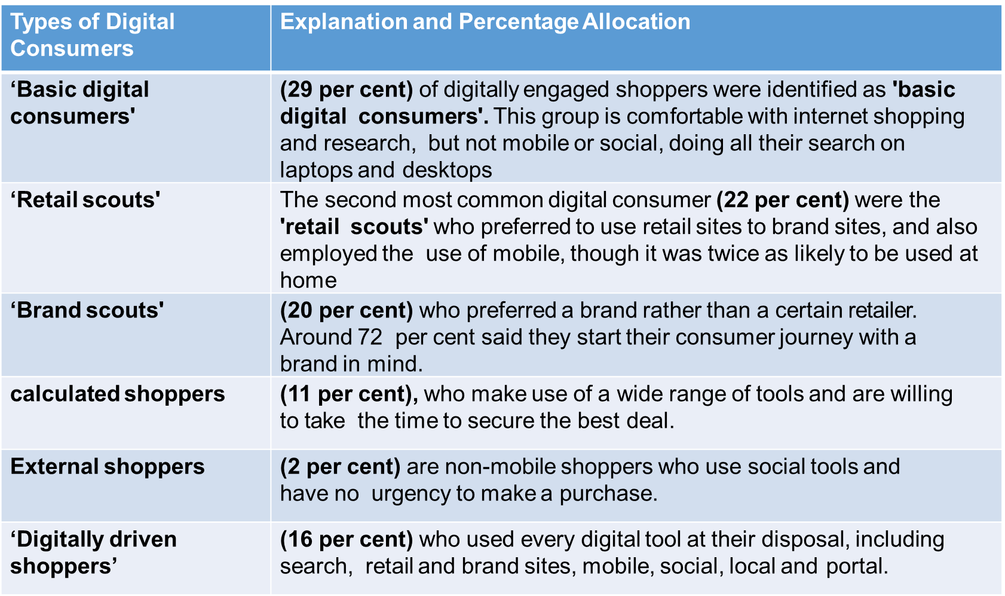
Digital Customers (CO1)

Slide 56
Digital consumer journey (CO1)
The digital customer journey is the path an online user takes to find your business. It’s a journey that’s made up of every single interaction a customer has with your company, from social media to your actual website.

Slide 57
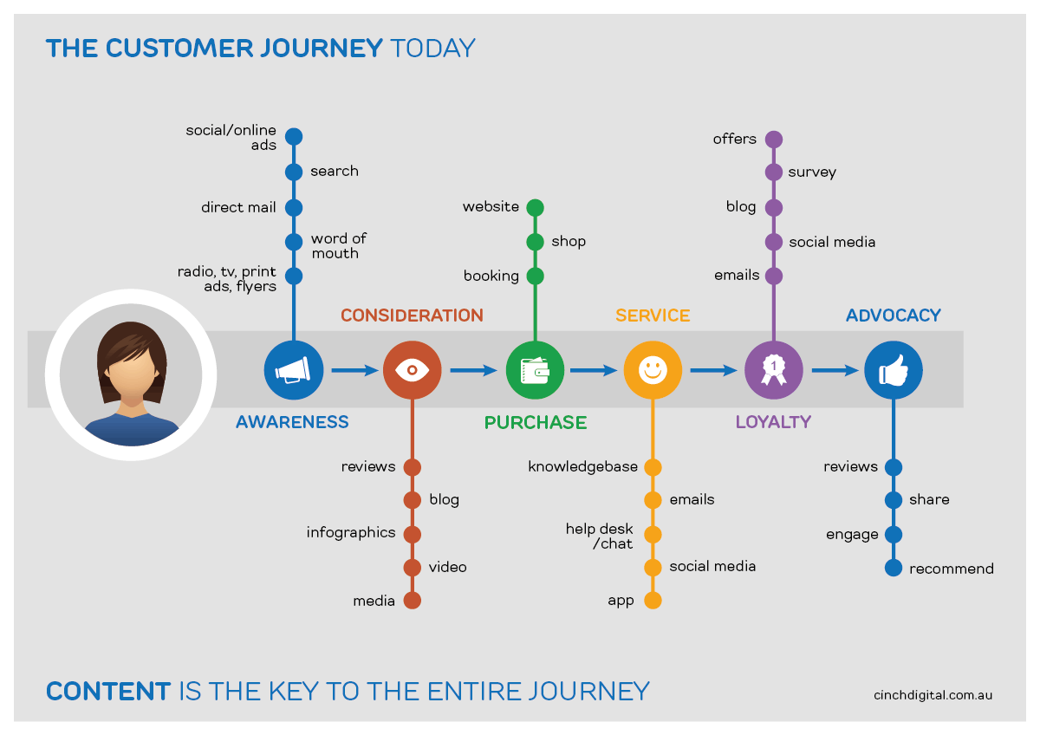
Digital consumer journey (CO1)

Slide 58
Daily Quiz (CO1)
______ are customers who prefer a certain brand rather than a retailer.
Eternal shoppers make use a wide variety of tools to secure the best deal. (True/False)
The discovery stage when your customer realizes they need something is known as _____.
In this stage, the customer will determine if what was expected is what they received and determine if they are satisfied.
Awareness b. Consideration
c. Fulfillment d. Experience

Slide 59
Noida Institute of Engineering and Technology, Greater Noida
(Unit –I) Topic 4
Marketing strategies for the digital world-latest practices.

Slide 60
Recap
6 main types of Digital consumers are:
Digitally Driven Segment
Calculated Shoppers
Basic Digital Consumers
Retail Scouts
Brand Scouts
Eternal Shoppers

Slide 61
Session Objectives
1. To explain the different Marketing strategies For The digital World.

Slide 62
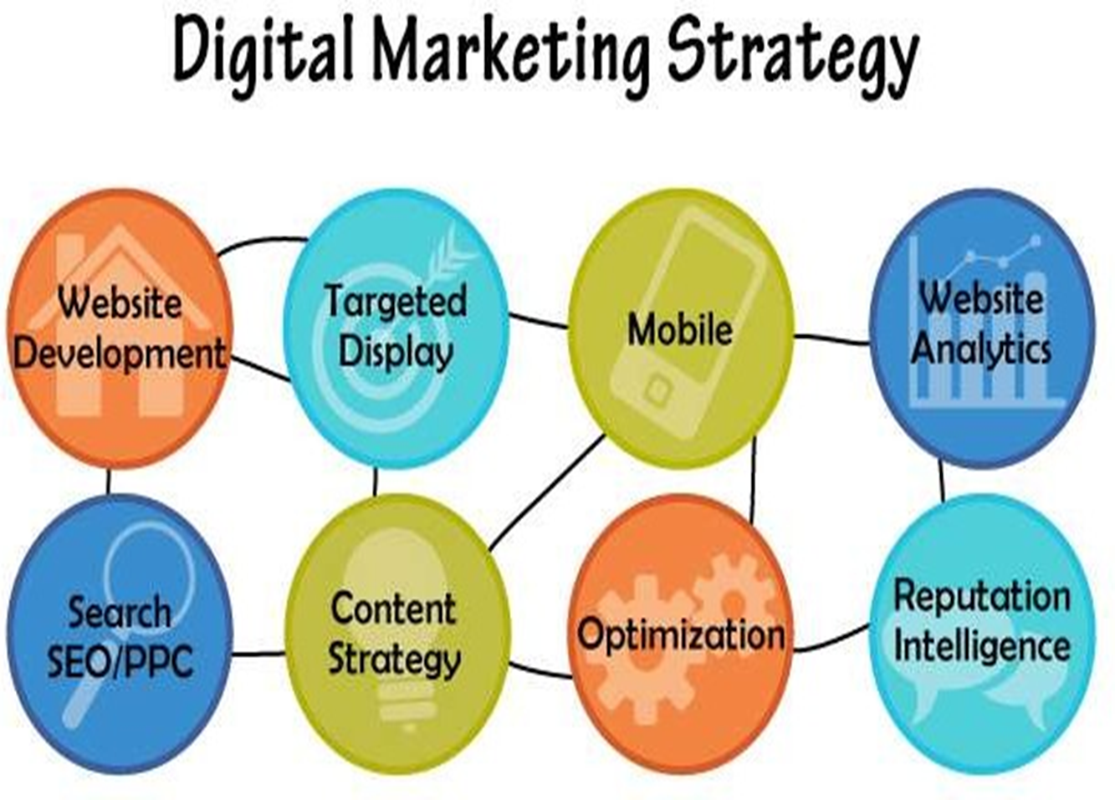
Marketing Strategies For The Digital World(CO1)

Slide 63
Marketing Strategies For The Digital World(CO1)
A digital marketing strategy is a roadmap you need to grow your business.
It is realized through the use of various marketing channels.
Why you need a digital marketing strategy:
Increased return on investments.
Structuring actions.
Analysis of audience reaction.
Collection of real statistics.

Slide 64
Developing a Digital Marketing Strategy (CO1)
Set a goal
Find out your target audience
Describe your client’s profile
Identify effective marketing channels

Slide 65
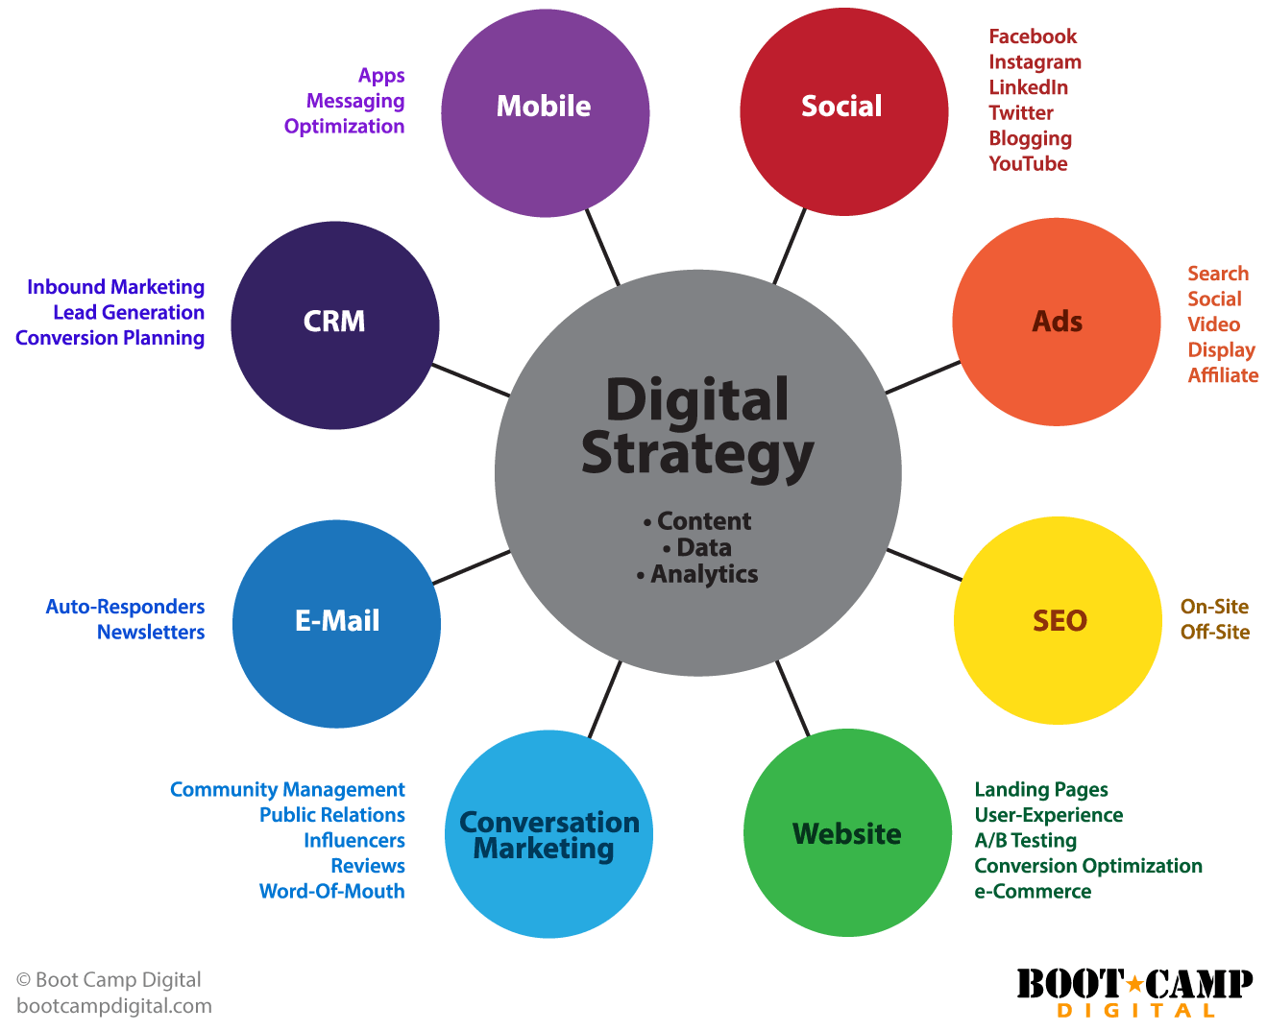
Marketing Strategies For The Digital World(CO1)

Slide 66

Case study for Digital Marketing Strategy(CO1)

Slide 67
Case study for Digital Marketing Strategy(CO1)
Lay’s is a potato chips company. It is an offshoot of the PepsiCo holding.
The essence of the unique #SmileDekeDekho ad campaign was a simple smile.
350 influential and popular personalities from all over the world were selected to promote the company.
They became the brand ambassadors and the faces of the advertising campaign.

Slide 68
Case study for Digital Marketing Strategy(CO1)
Why this marketing strategy was successful:
Snapchat and Instagram users took photos with a packet of chips and thus attracted new customers.
Good mood after purchase.
A pack of chips was associated with a smile and a positive mood for consumers.

Slide 69
Daily Quiz
1. This is the process of marketing accomplished or facilitated through the application of electronic devices, appliances, tools, techniques, technologies and or systems:
A. Direct Marketing B. Interactive marketing C. Electronic marketing D. Internet marketing
2. Marketing strategy contains the steps you need to take towards achieving your goals. (True/False)
3. _______ is a good opportunity to promote a product or service on social network.
4. Marketing ________ are a set of tools for successfully implementing a marketing strategy

Slide 70
Assignment
1 | Discuss the importance of Digital marketing in today’s world (with special reference to COVID times).
2 | Explain how do Digital Consumers make their purchase with appropriate examples.
3 | Develop an Online marketing mix for a business of your choice.

Slide 71
Topic Links and Online Courses Details
https://www.youtube.com/watch?v=aC-DwwgqG6A
https://www.youtube.com/watch?v=KlTTWj4wTqE
https://www.youtube.com/watch?v=lEF8yxSDejk
https://academy.hubspot.com/courses/digital-marketing
https://www.youtube.com/watch?v=ZVuHLPl69mM
https://www.youtube.com/watch?v=2ydz3DjkFS0&t=35s
https://www.youtube.com/watch?v=2ydz3DjkFS0&t=35s
https://www.udemy.com/courses/marketing/digital-marketing/
https://www.coursera.org/specializations/digital-marketing

Slide 72
MCQ s
1. What are some examples of digital marketing?
Social Media Marketing
Search Engine Marketing
Search Engine Optimization
All of the above
2. The term Digital Marketing was first used in the .............
1999s.
1990s
1980s.
1989s.
3. What is the best way to promote a business with social media?
Choose the Right Platforms
Encourage Engagement
Provide Value & Don’t Over-Promote
All of the above

Slide 73
MCQ s
4. What do you mean by Digital marketing?
Digital marketing is referred to as online marketing, web marketing, and internet marketing.
Analog Marketing
Shop
None of the above
5. Which one is the best way to promote a business online?
It offers a lot of helpful and free information.
To collect as many information as possible.
to advertise your company's product.
All of the above
6. ________ is an example of B to B service.
Youtube brand channel.
Google
Yahoo
None of the above

Slide 74
MCQs
7. The 4Ps of marketing as defined by Philip Kottler are:
Price, Product, Place, and Promotion
Price, Performance, Place, and Promotion
Price, Product, Place, and Positioning
PR, Product, Place, and Person
8. Which one of these statements is correct?
A. There is a slow decline in digital budgets with an average reduction of 10% in digital marketing budget. B. 98% of marketers affirm that offline and online marketing are merging C. Online marketing professionals are paid 50% less than marketing professionals. D. Around 25% of the global population is now on the Internet.

Slide 75
Glossary
Marketing automation, Digital platform, Native advertising, Viral marketing, Digital devices
_______ include smartphones, tablets, desktop computers, TVs and gaming devices.
_______ is the process of leveraging software to automate repetitive marketing tasks.
________ is a sales technique that involves organic or word-of-mouth information about a product or service to spread at an ever-increasing rate
_________is a browser or apps from the major platforms or services, that’s Facebook (and Instagram), Google (and YouTube), Twitter and LinkedIn.
5. _________ is the use of paid ads that match the look, feel and function of the media format in which they appear.

Slide 76
University paper Links
https://www.uptunotes.com/aktu-paper-digital-marketing-mammk04-2018-19/
http://www.aktuonline.com/papers/B.Tech-3-sem-digital-and-social-media-marketing-kmbmk03-2020.pdf
http://www.aktuonline.com/papers/B.Tech-3-sem-digital-marketing-rmbmk-03-2018-19.html

Slide 77
Sessional Question paper

Slide 78
Sessional Question paper

Slide 79
Sessional Question paper

Slide 80
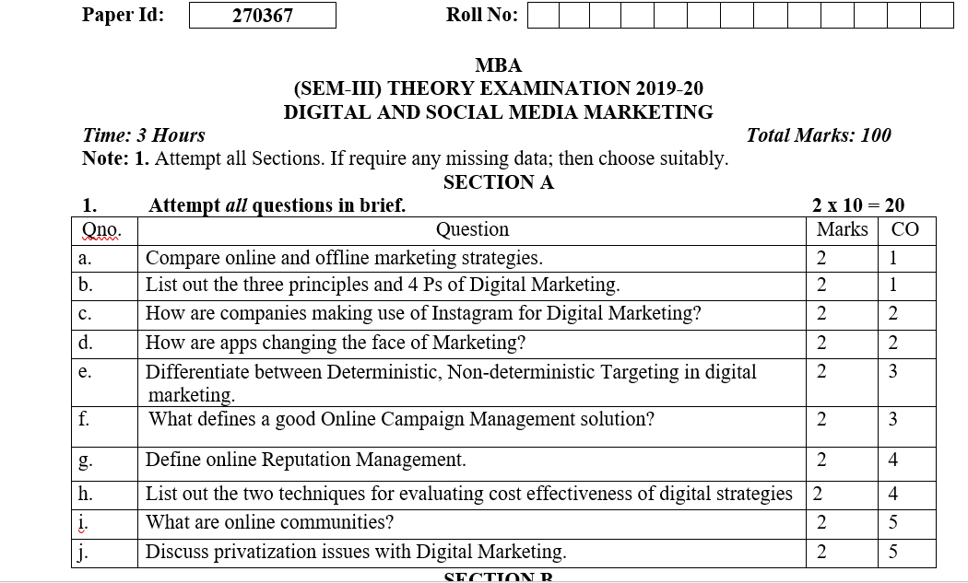
End Semester Question paper

Slide 81
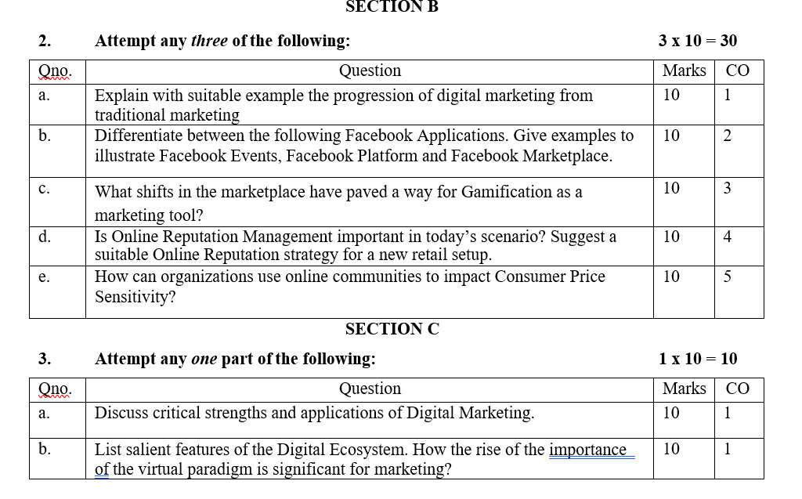
End Semester Question paper

Slide 82
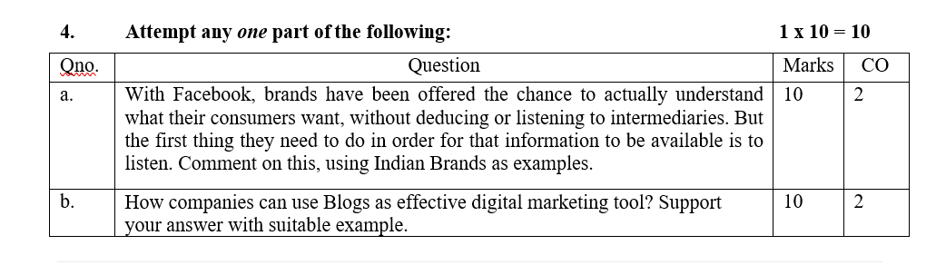
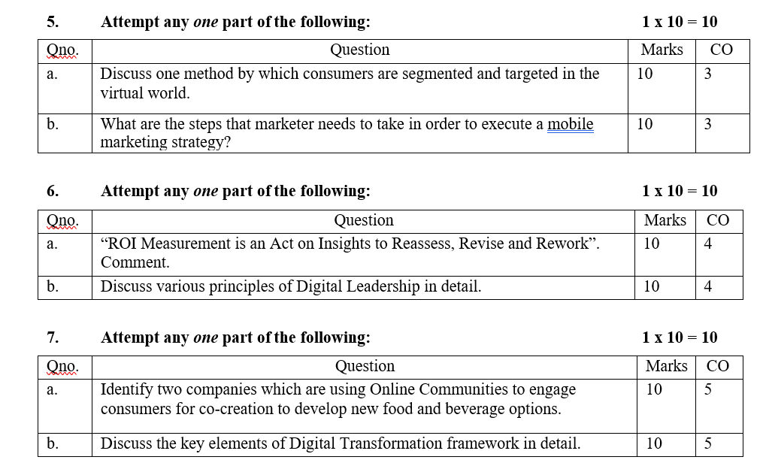
End Semester Question paper

Slide 83
Expected questions for University Exams
Q1.Explain what do you mean by term new digital world ? What are the key trends driving shift from tradition to digital marketing practices ?
Q2. Discuss the need for digital marketing in today’s digital world ?
Q3.Explain the 7 Ps of digital marketing in detail ?
Q4.Explain in detail the steps involved while crafting a digital marketing strategy ?
Q5.Throw light on the various market Strategies for the digital world.
Q6. Briefly discuss new digital paradigm changing the marketing world?
Q7. State the different types of Digital Marketing?
Q8. Name some useful Digital Marketing tools?
Q9. Explain PPC or Pay Per Click advertising?
Q10. State the limitations of Online Marketing.
Q11. Explain what do you know about Email Marketing.
Q12. Give reasons why Online marketing is preferred over Offline marketing.

Slide 84
Summary
Digital marketing is a subset of traditional marketing. It promotes your brand or products using digital channels such as the internet, emails and mobile phones, as opposed to more traditional media such as print, radio, TV or billboards. Finding new customers is the main aim of digital marketing. It has the advantage over traditional marketing techniques because online programs such as Google Analytics exist which enable you to analyze your marketing campaigns in real time. This is far faster than any non-digital technique.

Slide 85
References
https://www.equinetacademy.com/what-is-digital-marketing/
https://www.intelligenthq.com/the-six-types-of-digital-consumers/
https://engaiodigital.com/online-marketing-mix/
https://www.plerdy.com/blog/digital-marketing-strategy/
Moutsy Maiti: Internet Marketing, Oxford University Press India
Vandana, Ahuja; Digital Marketing, Oxford University Press India (November, 2015).
Ryan, Damian; Understanding Digital Marketing: marketing strategies for engaging the digital generation; Kogan Page (3rd Edition, 2014).
Tracy L. Tuten & Michael R. Solomon : Social Media Marketing (Sage Publication)

